Slide 1


Foreign Exchange Management Act, 1999
DECEMBER 02, 2023
PRESENTED BY: TANVI DURIYAL, ANSH SACHDEVA
MENTORED BY: CA VIJETA

Slide 2


Topic Description
FEMA Overview & Basic Compliances
vkalra.com

Slide 3


FERA V/S FEMA
If there was a need for transferring of funds for external operations, then prior approval of the Reserve Bank of India (RBI) is required. | For External trade and remittances, there is no need for prior approval from the Reserve Bank of India (RBI).
If there was a violation of FERA rules, then it was considered as Criminal offence. | If there was a violation of FEMA rules, then it is considered as civil offence
The objective of FERA was conservation of Foreign Exchange | The objective of FEMA is Management of Foreign Exchange
FERA rules regulated foreign payments. | FEMA focused on increasing the foreign exchange reserves of India, focused on promoting foreign payments and foreign trade.
FERA rules regulated foreign payments. | FEMA focused on increasing the foreign exchange reserves of India, focused on promoting foreign payments and foreign trade.
FERA has 81 sections | FEMA has 49 sections
vkalra.com

Slide 4
Individual
1. A person residing in India for more than 182 days during the course of the preceding financial year
but does not include–
a. person who has gone out of India or who stays outside India, in either case-
1. For or on taking up employment outside India, or
2. For carrying on outside India a business or vocation outside India, or
3. For any other purpose, in such circumstances as would indicate his intention to stay outside India for an uncertain period
A person other than a PRI.
Others
1. Any person or body corporate registered or incorporated in India.
2. An office, branch or agency in India owned or controlled by a person resident outside India.
3. An office, branch or agency outside India owned or controlled by a person resident in India
PRI/PROI
.
vkalra.com

Slide 5
Points to Remember
1. Definition of FEMA is based on:
a) Period, and
b)Purpose of stay in India
2.Period of stay is based on Preceding FY while the purpose of stay in India is based on Current FY.
3.Stay in India has to be More than 182 days , i.e. minimum of 183 days.
4.Under FEMA , the residential status can change on a daily basis unlike the IT Act.
vkalra.com

Slide 6
NRO/ NRE/ FCNR Accounts
NRE Account
NRO Account
The NRE account is an Indian rupee-denominated account, offering complete security.
You can transfer your funds (Principal & Interest amount) to a foreign account from an NRE account without any complications and restrictions
You need to note that the amount you deposit into these accounts must be earned outside India
The international debit card enables you to transact and withdraw money 24*7. Also, mutual fund investments to become effortless and instant if you link your NRE account number to the investment account.
An NRO account is a savings or current account held by NRIs in India to manage their income earned in India
Account-holders can deposit and manage their accumulated rupee funds without any hassle.
The account allows you to receive funds in Indian or Foreign currency.
You can apply for an NRO account jointly with a resident Indian or even an NR

Slide 7
Differences and Similarities Between NRE and NRO accounts
One can freely Repatriate any amount of money from the NRE account but NRO account carries a certain limit. Only USD 1 Million (Principal)can be repatriated in a FY , however there is no limit for interest.
Amount can be transferred from one NRE account to another NRE or another NRO account , however amount from one NRO account cannot be transferred to a NRE account.
Interest received from a NRE account is not subject to tax, however interest from a NRO account is subject to tax in India as per applicable slab rate.
NRE accounts are subject to conversion loss and fluctuation in the value of rupee against a foreign currency. There are no risks involved in NRO accounts

Slide 8
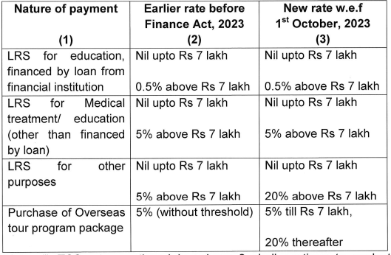
LR Scheme
(Liberalised Remittance Scheme)
Eligibility – Resident Individual including Minors
Limit – $ 2,50,000
Remittance only for the permissible transactions or the transactions that are not prohibited
Here, the term $ means any freely convertible currency.
The money can only be remitted by filing FormA2 with Bank and Form 15CA on the I.Tax Portal.
TCS is required to be deducted before remittance which also gets reflected in AIS.
vkalra.com

Slide 9
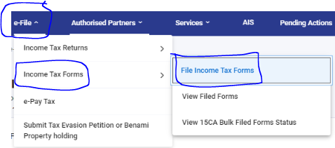
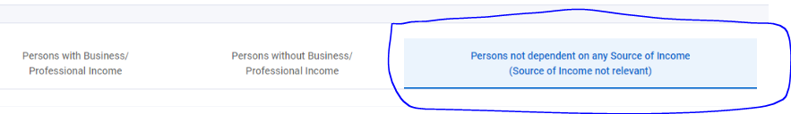
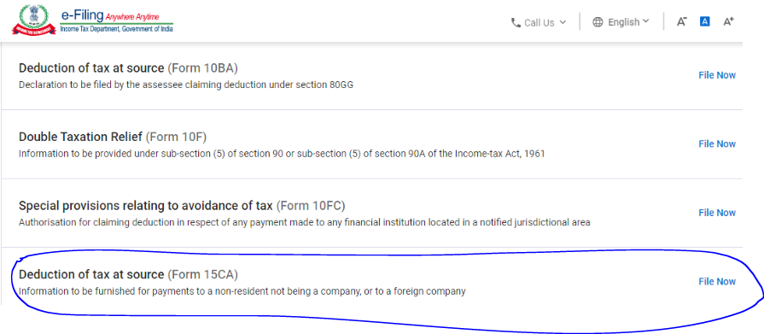
Compliances Related to LRS:
Form 15CA
1
2
3

Slide 10




Indian Resident
America
(Host Country)
Indian Company
America
100% Subsy
OVERSEAS DIRECT INVESTMENT
vkalra.com

Slide 11
Indian Investment Abroad
Who can do Investment abroad?
Indian Party
Resident Individual
Routes for Investment by Indian Party
Automatic Route
Max Investment (Lower of) :
  400 Billion $
  400% of Net Worth
No prior approval of RBI required
Key Compliances:
  Form ODI to be submitted with bank
  Shall not be on defaulters list of CIBIL or any other rating agency
  All investment in JV/WOS through 1 AD
Approval Route
Applicable where amount of investment exceeds the limits mentioned in Automatic Route
Prior approval of RBI is required.
Key Compliances:
  Submission of Application to RBI containing Nature of Investment, Financial Position of Remitter, Board Resolution, Amount of Investment
  FLA Return to be filed
  Annual Performance Report in form ODI II

Slide 12



Foreign Direct Investment
vkalra.com

Slide 13
Investment in India
Who can do Investment in India?
  Individuals
  Company in Foreign Country
Routes of FDI
Prohibited FDI
  Chit Fund Business
  Nidhi Company
  Agriculture or Plantation Activities
  Trading in Transferrable Development Rights
  Real Estate Business or Construction of Farm House (other than Township, Construction of Residential/Commercial Premises, Roads, Bridges, REITs)
Automatic Route
Approval Route

Slide 14
FAQ’s
Can a resident Open and maintain a FC account ?
A person resident in India may maintain a foreign currency account outside India if he had maintained it when he was resident outside India or inherited it from a person resident outside India.
Can a resident give gift to NRI relative?
Resident individual can make a rupee gift to an NRI who is a close relative of such resident individual [relative’ as defined in Section 2(77) of the Companies Act, 2013] by way of crossed chq /electronic transfer. The amount should be credited to the NRO a/c of the NRI.
The gift amount would be within the overall limit of USD 250,000 per FY as permitted under the LRS for a resident individual.
Can a resident borrow money (Rupee) from NRI’s ?
A person resident in India may borrow in Indian rupees from NRIs/PIOs after satisfying the following terms and conditions:
Borrowing shall be only on a non-repatriation basis;
The amount of loan should be received either by inward remittance from outside India or by debit to NRE/NRO account of the lender maintained with AD in India;
Period of loan shall not exceed 3 years;
Rate of interest on the loan shall not be more than 2% above Bank Rate prevailing on the date of availment of loan;
Payment of interest and repayment of principal shall be made only to the NRO account of the lender.
vkalra.com

Slide 15
      Can a person Borrow in Forex from Close Relatives Abroad ?
A per these provisions an individual resident may borrow a sum not exceeding USD 2,50,000 or its equivalent from close relatives residing outside India, subject to the conditions that :
the minimum maturity period of the loan is one year;
the loan is free of interest; and
the amount of loan is received by way of inward remittances in free foreign exchange through normal banking channels or by debit to the NRE/FCNR(B) account of the non resident lender.
      Can a resident acquire immovable property outside India?
A person resident in India may acquire immovable property outside India by way of inheritance or gift or purchase from a person resident in India who has acquired such property as per the foreign exchange provisions in force at the time of such acquisition.
A person resident in India may acquire immovable property outside India from a person resident outside India–
(a) by way of inheritance;
(b) by way of purchase out of foreign exchange held in RFC account
(c) by way of purchase out of the remittances sent under the Liberalised Remittance Scheme instituted by the Reserve Bank:
An Indian entity having an overseas office may acquire immovable property outside India for the business and residential purposes of its staff, as per the directions issued by the Reserve Bank from time to time;

Slide 16
Q1: Mr Arvind had resided in India during the FY 2021-22 for less than 183 days. He had come to India on April,1, 2022 for employment in VKC. What would be his residential status during the FY 2022-23?
PRI
Mr Arvind has come to India on April 1st 2022 for employment purpose, in this case notwithstanding the fact that he did not stay in India for more than 182 days in the preceding FY , he would be considered as a PRI as he has come to India in the Current FY for Employment purposes.

Slide 17
Q2: LRS Scheme available for Corporates/ Trusts/ Firms/ Individuals. Pl select the correct option from below:
Available to Companies only
Available to Companies and Individuals
Available to Individuals only
No, not available to any of the above

Slide 18
Q3: Mr Vincent a PROI comes to India for travel purpose, wishes to acquire a land which is not agricultural land, from the options below select the correct option for the acceptable mode of payment to acquire such land:
Payment through the funds held in NRE/FCNR/NRO a/c
Payment in Foreign currency notes
Payment through traveller's cheque
All of the above

Slide 19
Q4: What is the date by which FLA Return should be filed?
September 30
October 15
July 31
July 15

Slide 20
Q5: Mr Andley a person wants to visit India as a tourist, which account can he open and for how much period(i.e. years or months)?
NRO a/c for a period not exceeding 6 months

Slide 21
Q6: Out of the following, which resident individual can open a foreign currency account outside India?
A student who has gone abroad for studies
A resident who has gone to a foreign country for indefinite period
A person going abroad to participate in an exhibition/ trade fair & For the purpose of sending remittances under the Liberalized Remittance Scheme.
All of the above

Slide 22
Q7: Ms Aradhana had resided in India during FY 2021-22 for less than 183 days. She had come to India on April 1 2022 for business. She intends to leave the business on April 30 2023 and leave India on June 30 2023. What would be her residential status during FY 2022-23 and FY 2023-24 upto the date of departure?
No of Days of Stay in FY
Previous FY
Financial Year
No of Days of Stay in FY | Previous FY | Current Financial Year | Residential Status
Less than 183 days | 2021-22 | 2022-23 | PRI
More than 182 days | 2022-23 | 2023-24 | Till 30th June- PRI After that PROI

Slide 23
Q8: What is the period within which APR should be filed with RBI?
Withing 6 months from the end of Financial Year
Withing 3 months from the end of Financial Year
Withing 12 months from the end of Financial Year
Withing 9 months from the end of Financial Year

Slide 24



Thank You
3rd Floor, MJ Tower,
55, Rajpur Road,
Dehradun - 248001
T: +91.135.2743283
+91.135.2747084
W: vkalra.com
Follow us on

